Slide 1
Bass Diffusion Model
Will Your New Product Be a Hit?

Slide 2
Introduction
Businesses regularly invest large sums of money in new product development. If the product does not sell well, these investments can reduce the company’s value or share price. It is therefore of critical importance to predict future sales of a product before a product comes to market.
This is where the Bass Diffusion Model comes in. Named after Frank Bass in 1963, he detailed a mathematical model to predict the growth of consumer durables.

Slide 3
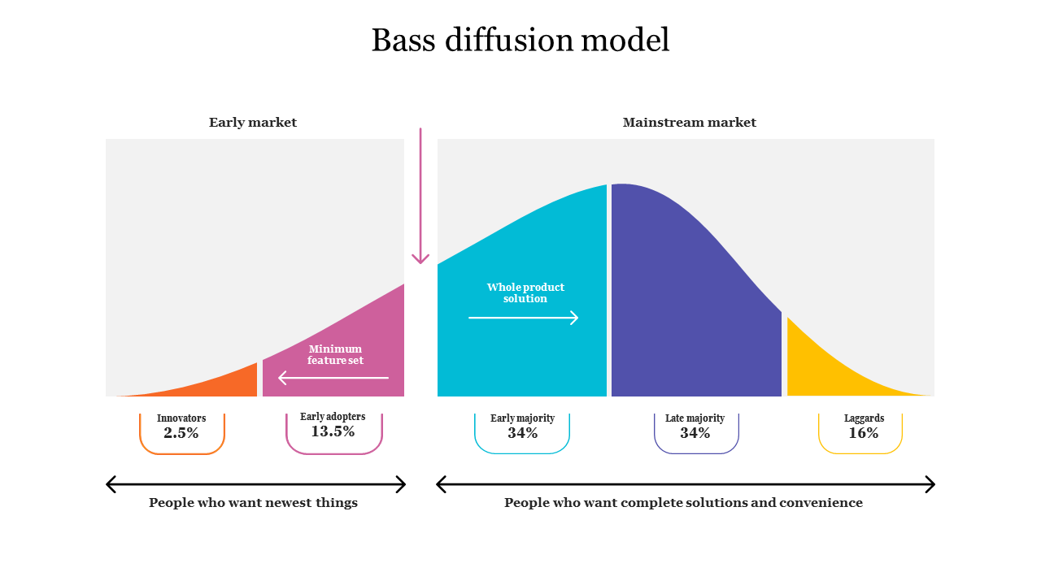
Introduction

Slide 4
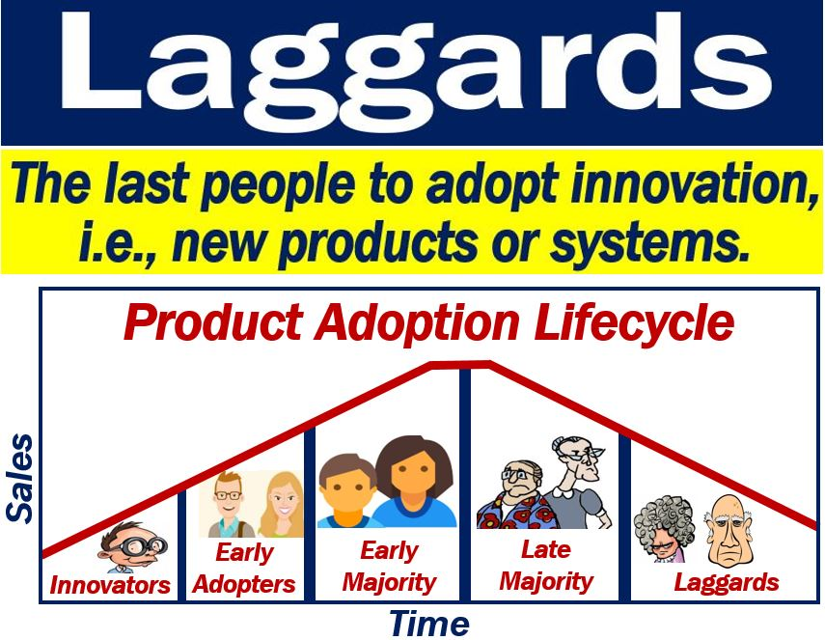
Introduction
The Bass model asserts that diffusion of a new product is driven by two types of people:
■ Innovators: Innovators are people who seek new products without caring if other people have adopted the new product.
■ Imitators: Imitators are people who wait to try a product until other people have successfully used the product.

Slide 5
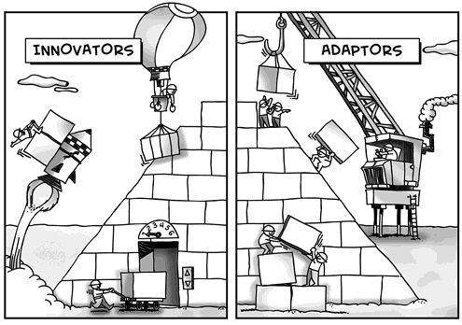
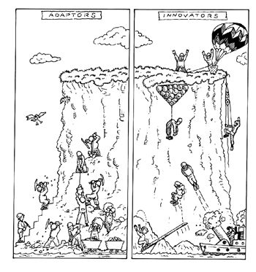

Slide 6
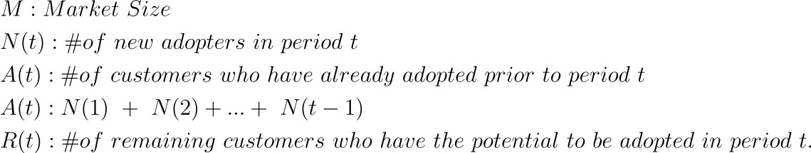

Bass Model
The components of the bass model.
What is remaining?

Slide 7
Bass Model
Now, this is where Bass incorporated his idea. Essentially, he broke down product adoption into 2 categories:
Consumers who adopted the product because they wanted to be on the bleeding edge, experimenting with new products. The Innovators.
Consumers who adopted the product simply because others were buying the product. This could be due to word of mouth, peer influence, etc. The Imitators. One thing to note here is, the level of imitation depends on the number of people who have already adopted the product (think exponential).

Slide 8
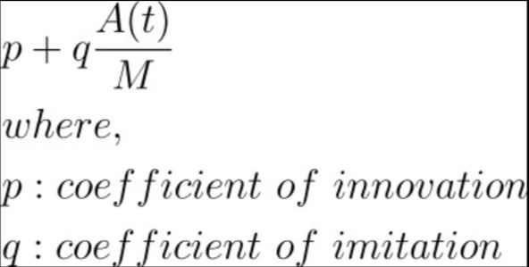
Bass Model
Based on this, bass computed the probability of being adopted, at a given time (t).
As mentioned, the probability of imitation depends on the number of people already adopted (A(t)). For probability, we divide by M.

Slide 9
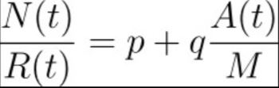
Bass Model
As we know that this probability is the ratio of customers adopted in time period t to the potential candidate pool of customers in time t, the following can be equated:
Solve for N(t) ?
Reference : https://srdas.github.io/MLBook/productForecastingBassModel.html

Slide 10
Bass Model
In Summary:
p is the coefficient on innovation.
q is the coefficient of imitation.
N(t) gives new adopters at a given time t.
M is the Absolute Market Share.
Hence, if we can find p and q for a product, we can forecast its adoption over time, and thereby generate a time path of sales.
Fareena Sultan, John Farley, and Donald Lehmann summarized the estimated Bass model parameters for 213 products in their work “A Meta-Analysis of Applications of Diffusion Models,” (Journal of Marketing Research, 1990, pp. 70–77) and found an average value of 0.03 for P and 0.30 for Q. This indicates that imitation is much more important than innovation in facilitating product diffusion.

Slide 11
Let’s solve a case
It is difficult to predict the sales of a new product before it comes to market, but an approach that has proven useful in the past is to look for a similar product or industry that has already reached market maturity (for example, a color TV might be an analog for DIRECTV). Similar products or industries are often referred to as adjacent industries/categories. You can use the values of P and Q for the analogous product and an estimated value of N for the new product to forecast sales.
To fit the Bass model, you must find values of P, Q, and N, which accurately predict each period’s actual sales (n(t)). To estimate P, Q, and N, use the Solver. To illustrate the estimation of the Bass model, use U.S. sales of color TVs;
The file ColorTV.xls contains 16 years of color TV sales (1964–1979).

Slide 12
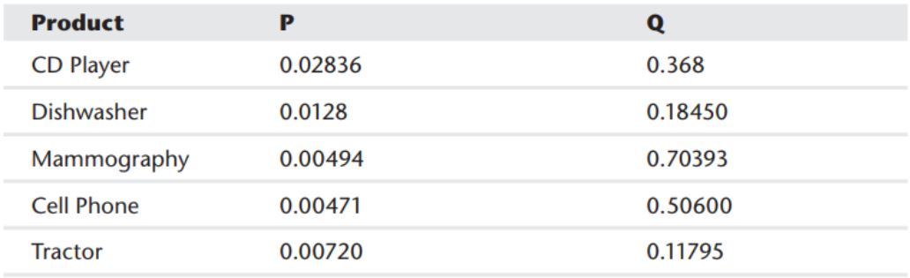
Bass Model(Few) Estimates:

Slide 13
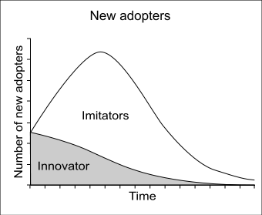
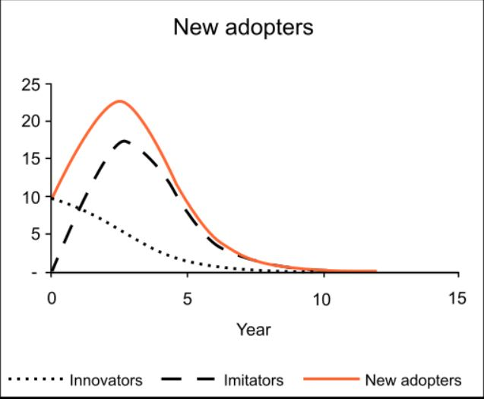
Let’s visualize Bass Model in Python
So how does it actually look like in practice? Let’s experiment with a few values of p & q. M will be fixed to 100 (units, not a %).
Reference : https://medium.com/@rkaahean/the-bass-diffusion-model-a-gentle-introduction-i-b9b4fe3cd94e

Slide 14
To Conclude:
The Bass model breaks down product sales into an innovation (P) and imitation (Q) factor.
The GRG Multistart Solver Engine can be used to estimate P, Q, and N.
By using an analogous product to estimate P and Q and intentions data to estimate N, you can use the Bass model to estimate new product sales before the product is launched.
By randomly drawing values of P and Q from a set of analogous products and modeling N as a normal random variable, you can simulate the range of possible product sales.

